Slide 1

Assessing Vulnerabilities and Penetration Testing

Slide 2
Vulnerability Scanners
Vulnerability scanners are automated tools that scan hosts and networks for known vulnerabilities and weaknesses
Credentialed vs. non-credentialed
Used along with other reconnaissance information to prepare for and plan attacks

Slide 3
Credentialed and Non-Credentialed Scanning
Uses user privileges to analyze the system and find issues
Example: Microsoft Baseline Security Analysis
Used by system admins to get a detailed look at system configuration
Scans are run with zero privileges, most of the time run from a different machine over the network
Example: Nessus Vulnerability Scanner
Gives you a view of the computer from the standpoint of an attacker

Slide 4
How Vulnerability Scanners Work
Similar to virus scanning software:
Contain a database of vulnerability signatures that the tool searches for on a target system
Cannot find vulnerabilities not in the database
New vulnerabilities are discovered often
Vulnerability database must be updated regularly

Slide 5
Typical Vulnerabilities Checked
Network vulnerabilities
Host-based (OS) vulnerabilities
Misconfigured file permissions
Open services
Missing patches
Vulnerabilities in commonly exploited applications (e.g. Web, DNS, and mail servers)

Slide 6
Vulnerability Scanners: Benefits
Very good at checking for hundreds (or thousands) of potential problems quickly
Automated
Regularly
May catch mistakes/oversights by the system or network administrator
Defense in depth

Slide 7
Vulnerability Scanners: Drawbacks
Report “potential” vulnerabilities
Only as good as the vulnerability database
Can cause complacency
Cannot match the skill of a talented attacker
Can cause self-inflicted wounds

Slide 8
Attackers use Vulnerability Scanners Too
From network scanning an attacker has learned:
List of addresses of live hosts
Network topology
OS on live hosts
Open ports on live hosts
Service name and program version on open ports
Now use vulnerability scanners to find vulnerable services

Slide 9
Popular Security Tools
“The network security community's favorite tools.”
The list:
http://sectools.org/
Nessus
Nmap
Wireshark
…

Slide 10
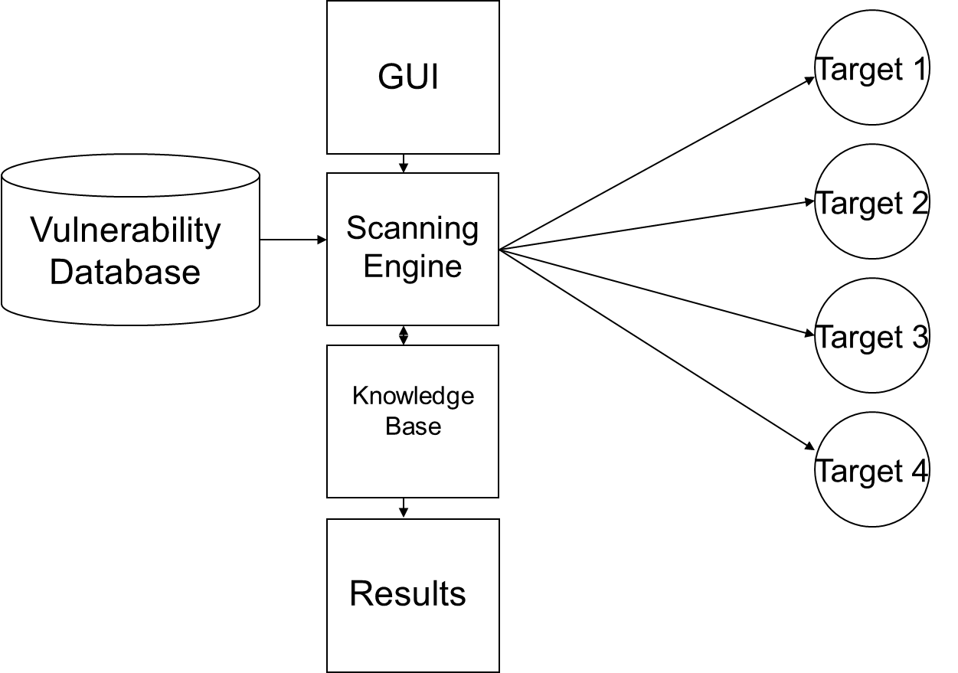
How Vulnerability Scanners Work

Slide 11
Typical Vulnerabilities Checked
Common configuration errors
Examples: weak/no passwords
Default configuration weaknesses
Examples: default accounts and passwords
Well-known system/application vulnerabilities
Examples:
Missing OS patches
An old, vulnerable version of a web server

Slide 12
Nessus
Free, open-source vulnerability scanner
URL: http://www.tenable.com/products/nessus
Two major components:
Server
Vulnerability database
Scanning engine
(Web) Client
Configure a scan
View results of a scan

Slide 13
Nessus Plug-ins
Vulnerability checks are modularized:
Each vulnerability is checked by a small program called a plug-in
More than 20,000 plug-ins form the Nessus vulnerability database (updated regularly)
Customizable – user can write new plug-ins
In C
In Nessus Attack-Scripting Language (NASL)

Slide 14
Vulnerabilities Checked by Nessus
Some major plug-in groups:
Windows
Backdoors
CGI abuses
Firewalls
FTP
Remote file access
RPC
SMTP
DOS

Slide 15
Running a Nessus Scan
Make sure the server is running and has the latest vulnerability database
Start the client
Connect to the server
Select which plug-ins to use
Select target systems to scan
Execute the scan
View the results

Slide 16
Nessus Results
Vulnerabilities ranked as high, medium, or low risk
Need to be checked (and interpreted)
Can be used to search for/create exploits along with previous information collected:
OS type
List of open ports
List of services and versions
List of vulnerabilities

Slide 17
Nikto: A Web Vulnerability Scanner
URL: http://cirt.net/nikto2
Vulnerability scanner for web servers
Similar to Nessus - runs off plug-ins
Tests for:
Web server version
Known dangerous files/CGI scripts
Version-specific problems

Slide 18
Security Templates
A Windows security template is a file (.inf) that lists recommended configuration parameters for various system settings:
Account policies
Local policies
Event log
Restricted groups
System services
Registry
File system

Slide 19
Security Templates (cont)
There are several default security templates defined by Microsoft:
Default security – from a default installation of the OS
Compatible – modifies permissions on files and registry to loosen security settings for user accounts (designed to increase application compatibility)
Secure – increases security by modifying password, lockout, and audit settings
Highly secure – does everything the secure template does plus more
There are templates defined by others, and an administrator can customize his/her own templates

Slide 20
Security Configuration and Analysis Utility
Can be used to:
Save current system settings to a template
Compare the current system settings against a preconfigured template
Apply the settings in a preconfigured template to the system

Slide 21
Security Configuration and Analysis Utility (cont)
Running:
Run Microsoft Management Console (MMC)
Add Security Configuration and Analysis Snap-in
Open a (new) database
Analyze/Configure computer now

Slide 22
Security Configuration Wizard
An attack surface reduction tool
For Windows 2003 Server SP1 and later
Determines the minimum functionality for server’s role or roles
Disables functionality that is not required
Run off of a file (.xml) that lists recommended configuration parameters for various system settings

Slide 23
Security Configuration Wizard (cont)
Disables functionality that is not required
Disables unneeded services
Blocks unused ports
Allows further address or security restrictions for ports that are left open
Prohibits unnecessary IIS web extensions, if applicable
Reduces protocol exposure to server message block (SMB), LanMan, and Lightweight Directory Access Protocol (LDAP)
Defines a high signal-to-noise audit policy

Slide 24
Security Configuration Wizard (cont)
Running
From Control Panel -> Add/Remove New Programs
Add/Remove Windows Components
Security Configuration Wizard
Run from Administrative Tools
Analyze system settings
Configure system settings

Slide 25
Summary - Vulnerabilities
Vulnerability scanners are automated tools that scan hosts and networks for known vulnerabilities and weaknesses
Used by defenders to automatically check for many known problems
Used by attackers to prepare for and plan attacks
Configuration tools can help reduce attack surface

Slide 26
Penetration Testing

Slide 27
Penetration Testing Execution Standard (PTES)
“Penetration Testing is a way to simulate the methods that an attacker might use to circumvent security controls and gain access to a system.”¹
PTES, baseline fundamentals for performing a penetration test –
http://www.pentest-standard.org/
¹Kennedy, David, et. al. Metasploit: The Penetration Tester’s Guide. San Francisco: No Starch Press. 2011. Print.

Slide 28
PTES Phases
Pre-Engagement
Intelligence Gathering
Threat Modeling
Vulnerability Analysis
Exploitation
Post Exploitation
Reporting

Slide 29
1. Pre-Engagement
Discussing the scope and terms of the penetration test with your client
Convey the goals of the penetration test
-use this opportunity to discuss what will happen, the expectations of a full scale penetration test
- what will be tested – the need for total access to get a complete report

Slide 30
2. Intelligence Gathering
- Gather information about the organization (social media, Google hacking, etc)
- Start to probe the organization for ports with blocking (use a disposable IP address,
you will be blocked if this is turned on)
Test any Web Applications
Note: perform scans from an IP address range that cannot be traced back to you or your team. The initial probing can be performed from anywhere (except at your team’s office!).

Slide 31
3. Threat Modeling
Using the information acquired in the intelligence gathering.
Look at the organization as an adversary and determine
-where the threats are coming from,
-what form they may take
-and what they are after.

Slide 32
4. Vulnerability Analysis
You will use all the previous information from prior phases
This is a detailed analysis taking into account port and vulnerability scans, banner grabbing, and information from intelligence gathering.

Slide 33
5. Exploitation
The “glam” part of the penetration test
Often brute force (not very “glam”) instead of precision
Separates the “good” and the “bad” testers –
“Bad” testers will fire off massive onslaught of exploits
“Good” testers will perform only exploits expected to succeed based on info gathered
Creating “noise” with massive exploits and hoping for a result is not the way!

Slide 34
6. Post Exploitation
After you have compromised one or more systems (there are many more to come)
-Targets specific systems
-Identifies critical infrastructure
-Targets information or data of value to the company
Start with systems that will present the most business impact to the company if breached

Slide 35
Post Exploitation (Cont)
Take the time to determine what systems do and their different user roles
Ex: suppose you compromise a domain? Big deal.
What else could you do in terms of the systems that the business uses? Backdoor code on a financial application? What about their payroll system? Intellectual property?

Slide 36
7. Reporting
Most important element of the penetration test
Include at least:
Executive Summary
Executive Presentation
Technical Findings
Used by the client to remediate security holes
Be sure to warn the client about the thinking that fixing the hole solves the whole problem. Ex: sql injection vulnerability – they fix their problem, but have they addressed any 3rd party applications that are connected?

Slide 37
Types of Penetration Tests
1. Overt Penetration Testing
You work with the organization to identify the potential security threats
Advantages: full access without blocks, detection doesn’t matter, access to insider knowledge
Disadvantages: don’t get the opportunity to test incident response

Slide 38
Types of Penetration Tests (Cont)
2. Covert Penetration Testing
Performed to test the internal security team’s ability to detect and respond to an attack
Advantages: Test incident response, most closely simulates a true attack
Disadvantages: Costly, time consuming, require more skill
Note: because of cost of covert – most will target only one vulnerability, the one with easiest access – gaining access undetected is key

Slide 39
Vulnerability Scanners
Automated tools used to identify security flaws
1. Fingerprint a target’s operating system
2. Take one OS identified, use scanner to determine if vulnerabilities exist
Although Vulnerability Scanners play an essential role in Penetration Testing, a penetration test CANNOT be completed automated! Most penetration testers with years of experience rarely use vulnerability scanners – they rely more on their knowledge and experience – business knowledge is also a key factor.

Slide 40
PTES Methodology
You can use PTES or another methodology to perform a penetration test.
More important to have a standard, repeatable process that you follow.
OCD wins the prize!

